Slide 1
TITLE

Slide 2
Objective
To build an integrated system for emergency rescue services in the event of road accidents by using live box system .

Slide 3
ABSTRACT
In modern day vehicles accidents are one of the leading causes of fatalities.
An important indicator of survival rates after an accident is the time between the accident and when emergency medical personnel are dispatched to the accident location
The project focuses on building an infrastructure which vehicle safety authorities can enhance the crash reports post-crash analysis, record of the event and reduces the time to arrive at the crash location

Slide 4
Many kind of sensors are implemented in the vehicle and it is used in the real time applications effectively.

Slide 5
LITERATURE SURVEY
S.No | Title | Authors | Year | concep | Advantage | Disadvantage
1 | GPS Based Vehicle Tracking System | Mohd Hakimi Bin Zohari, Mohd Fiqri Bin Mohd Nazri | June 2021 | Track vehicles using Google Earth application develop in android application for mobile system | Wireless communication | Short range communication
2 | ACCIDENT DETECTION AND ALERT SYSTEM | Dr. C. K. Gomathy1, K Rohan2 , Bandi Mani Kiran Reddy3, Dr. V Geetha4 | may -2022 | This system aims to alert the nearby medical center about the accident to provide immediate medical ai | Easy to locate the accident place | Signal problem

Slide 6
S.No | Title | Authors | Year | concept | Advantage | Disadvantage
3 | A lane changing time point and path tracking framework for autonomous ground vehicle | Jiayu Fan Jun Liang Anjan K. Tula | sep 2021 | Based on traditional safety distance, a novel concept, that is the synthesized safety distance for lane changing (SSDLC), | Based on traditional safety distance, a novel concept, that is the synthesized safety distance for lane changing (SSDLC), | Huoptimal method cannot be applied for high speed driving maneuver with large angles of tire slip
4 | Navigation in GPS Spoofed Environment Using M-Best Positioning Algorithm and Data Association | BETHI PARDHASARADHI, (Member, IEEE), PATHIPATI SRIHARI , (Senior Member, IEEE), AND P. APARNA, (Senior Member, IEEE) | feb 2021 | proposed to accept the authentic GPS signals and spoofed GPS signals into the positioning algorithm and perform the robust positioning with all possible combinations of authentic and spoofed pseudorange measurements | The navigation lter is a three-dimensional KF with a constant velocity (CV) model, all the position estimates evolved at a specic epoch are observations. | this assumption is not valid in reality due to presence of clock offset in the satellites.

Slide 7
S.No | Title | Authors | Year | concept | Advantage | Disadvantage
5 | Real‑time GNSS precise point positioning with smartphones for vehicle navigation | Zishen Li1 , Liang Wang1*, Ningbo Wang1, Ran Li1 and Ang Liu1,2 | May 2021 | The availability of raw Global Navigation Satellite System (GNSS) measurements from Android smart devices gives new possibilities for precise positioning solutions | To promote the application of GNSS PPP for land vehicle navigation with smart devices, this contribution studies the real-time PPP with smartphones. | the carrier phase observations with smart devices are affected by duty-cycling issues

Slide 8
Existing system
In existing system they trigger for several types of crash such as vehicle getting, engine temperature & different road location.
An important indicator of survival rates after an accident is the time between the accident and when emergency medical personnel are dispatched to the accident location
Short range to communicate in zigbee between transmitter and receiver

Slide 9
Limitations
Human being is affected
Time delay for takes for emergency rescue to arrive at the crash location
Short range to communication

Slide 10
Proposed methods
In proposed system the Multi sensor are used in vehicle to detect and information through IOT and GPS in live box module .
The information has been sent to nearby base station or police station or hospital or home.
Panic switch use to control the sending information.
IOT module is used to storage the accident data and also used information send to designation

Slide 11
Power supply
BLACK BOX
Temperature
sensor
Panic switch
A
T
M
E
G
A
3
2
8
Gas sensor
LCD
Vibration sensor
Node Mcu
Webpage and Server
GPS

Slide 12
Advantages
Multiple communication can be achieved accurately.
The vehicle safety authorities can enhance the crash reports post-crash analysis, record of the event and reduces the time to arrive at the crash location..
The information sent to nearby base station or police station or hospital or home using live box
Multiple sensors are used for multiple purposes with help of GPS and IOT Module.

Slide 13
HARDWARE
1.Arduino Micro controller
2.GPS & IOT module
3.Temperature sensor
4.Gas sensor
5.Vibration sensor
6.LCD
7.Power supply

Slide 14
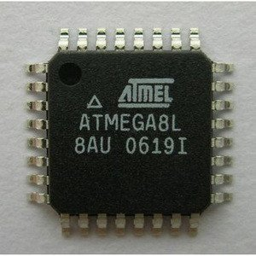
MODULES DESCRIPTION
ATMEGA 8
Atmega8 is one of the most advanced microcontroller from microchip.
It is used as an comparator to compare the input reference voltage and out put voltage to provide linear output.

Slide 15
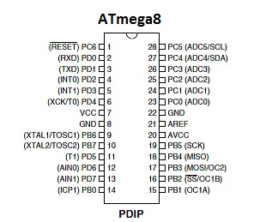
ATMEGA 08 PIN DIAGRAM

Slide 16
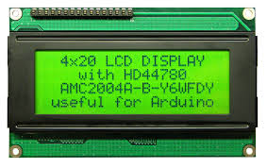
LCD DISPLAY
A liquid-crystal display (LCD) is a flat pane display, electronic visual display, or video display that uses the light modulating properties of liquid crystals.
Liquid crystals do not emit light directly.

Slide 17
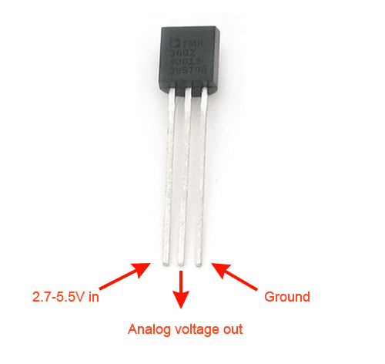
Temperature sensor

Slide 18
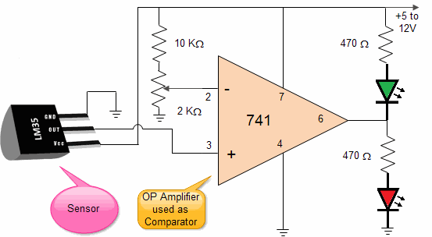
Circuit diagram

Slide 19
Explanation
The output of IC2 increases in proportion to the temperature by 10 mV per degree.
This varying voltage is feed to a comparator IC 741 (OP Amplifier).
OP Amplifier are among the most widely used electronic devices today.

Slide 20
Conti..
The op-amp is one type of differential amplifier. It has two input inverting (-) and non-inverting (+) and one output pin.
We have used IC741 as non-inverting amplifier which means pin 3 is the input and the output is not reversed. This circuit amplifies the difference between its input terminals.

Slide 21
IC LM35, IC LM741 Resistance: 10K Ohms, 470 Ohms X 2Pcs Preset or P.O.T of 2K Ohms LED 2pcs (Red and Green) 9V Battery with Snap

Slide 22
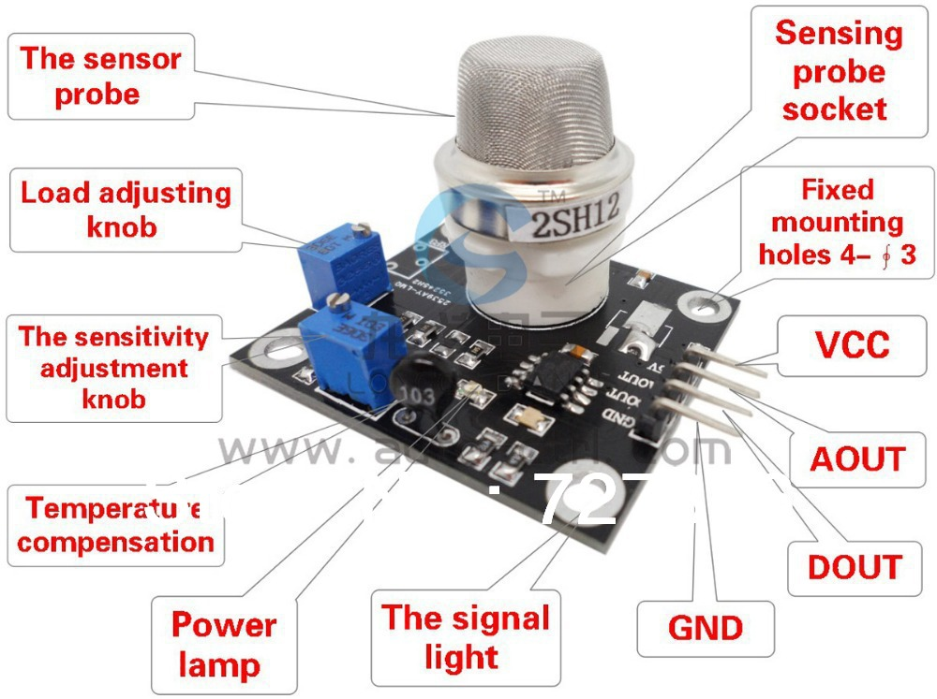
Gas sensor

Slide 23
Conti..
Mainly used for qualitative detection, for the family, the environment hazardous gas detection equipment, suitable for the detection of sulfur dioxide gas, gas sensors tested concentration range: 1 to 500ppm, detailed information on;

Slide 24
1, the heating voltage: 5 + 0.2V (AC . DC) 2, Working current: 150mA 3, the circuit voltage: DC5V (Max DC 24V) 4, the load resistance: 10K (adjustable) 5, the test concentration range :1-500ppm

Slide 25
6, clean air voltage: < 1.5V 7, Sensitivity: > 3% 8, Response Time: < 1s (3-5 Minute Warm-up, The Theory Preheating Time 48 Hours) 9, response time: < 30S 10, the component power consumption: < 0.8W 11, Working temperature: -10 ~ 50 ºC (nominal temperature 20 ºC)

Slide 26
SOFTWARE
Proteus
Ardiuno
PHP

Slide 27
REFERENCE
[1] J. Gray and B. Fitzgerald, “Flash disk opportunity for server applications,” ACM Queue, Vol.6(4), July/August 2018
[2] “Pure storage,” https://www.purestorage.com/.
[3] J. Colgrove, J. D. Davis, J. Hayes, E. L. Miller, C. Sandvig, R. Sears, A. Tamches, N. Vachharajani, and F. Wang, “Purity: Building fast, highly-available enterprise flash storage from commodity components,” in Proceedings of the 2015 ACM SIGMOD International Conference on Management of Data (SIGMOD ’20).
[4] “Netapp solidfire,” https://www.solidfire.com/.
[5] “Dell emc xtremio,” https://www.dellemc.com/en-us/storage/xtremio- all-flash.htm.

